Slide 1
Training and simulation programs can be enhanced by the structuring learning methods to deal with content load and overload, while developing applications more precisely relevant to real world usage. Additionally, the efficiency and effectiveness of training can be measured and adapting accordingly by integrating on-going monitoring via key performance indicators. This in turn allows organizations to go beyond training and to allow performance readiness to be realistically assessed.
IMPROVING WARFIGHTER TRAINING
NeuroTrackerX is leading the way in helping military organizations, general and special forces looking to improve war fighter training. Our cognitive enhancement training equips combat personnel with the necessary motor skills and functions to be more effective in critical conditions.

Slide 2
Problem: knowledge-based and expertise training has increased and complexified due to interaction with systems and machines.
Solution: increase learning capability by increasing attention and awareness capacities for better adaptability

Slide 3
Based on 20+ years of research at the University of Montreal, and commercialized by CogniSens, NeuroTracker is being used by over 25,000 athletes, students, employees, soldiers and active aging individuals in more than 550 installations worldwide. NeuroTracker research is supported by the non-profit CogniSens Applied Research Centre, which assists research groups around the globe to study how NeuroTracker can be applied in innovative ways to solve human performance needs in the marketplace.
NeuroTracker can expand the overall effectiveness of training and simulation by increasing learning abilities on several levels, as well as assessing readiness for training and measuring how well training transfers into expertise when performing under pressure. This multi-faceted approach makes it a flexible tool which can be used through several phases of training cycles. Additionally, NeuroTracker improves human performance generally.
IMPROVING WARFIGHTER TRAINING
NeuroTrackerX is leading the way in helping military organizations, general and special forces looking to improve war fighter training. Our cognitive enhancement training equips combat personnel with the necessary motor skills and functions to be be more effective in critical conditions.

Slide 4
NeuroTracker is a visual exercise that requires tracking multiple objects in a 3D environment.
The NeuroTracker task requires the brain to simultaneously elicit and integrate the neural systems for attention, working memory, impulse control and information processing, all components of executive function. As a result, multiple studies with NeuroTracker have clearly demonstrated transfer to improved attention systems, executive function, working memory, processing speed, and response control. These are cognitive abilities that are critical to human performance generally.
Multiple object tracking is the ability to visually and mentally stay aware of several things moving at the same time among distractors. NeuroTracker is a scientifically enhanced technique which utilizes multiple object tracking as a physics based simulation to deliver an effective and structured training method.
The key characteristics of NeuroTracker are:-
1) Multi-focal attention – dividing mental focus across several targets and maintaining it under pressure.
2) Large visual field – a wide field of view which tests peripheral vision capacities
3) Stereoscopy – 3D is required for stimulate dynamic depth processing and trigger higher level brain functions
4) Speed thresholds – controlling target velocity allows training difficulty to be precisely controlled, scientific algorithms are used automatically adapt speed at each athletes current processing limits.
This combination of features allows NeuroTracker to achieve high-level cognitive stimulation with any user within a minute, and because the training accurately adapts to their cognitive thresholds, it also provides a quantitative measure of the current mental state.
Though primarily a visual processing tasks, the type of stimulation it achieves triggers mental activity throughout high-level functions across the brain, including frontal lobe regions used in decision-making.
Finally NeuroTracker utilizes scientific algorithms that adjust speed, the number of targets tracked, and the duration of tracking to adapt overall difficulty to any users needs over time.
NeuroTracker training is highly efficient and effective ( 30 X 5 min sessions for sustained learning). It can be delivered anytime, anywhere there’s an internet connection and the user’s progress can be remotely monitored by the manager, coach, clinician or teacher.

Slide 5
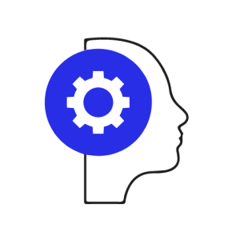
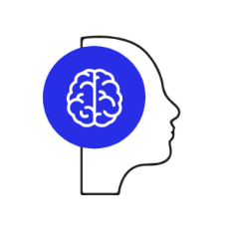
qEEG measures show that the effects after NeuroTracker training increases brainwave speed throughout many areas of the brain, including frontal lobe regions (involved in decision-making). Increased brainwave speeds relate to greater alertness, mental focus and sharpness. They are also associated with increased processing speed and neuroplasticity. Neuroplasticity is the be all and end all learning, allowing growth and increases in the efficiency of neural networks. By enhancing these processes NeuroTracker training is able to accelerate the learning rate of individuals as they progress through training programs.
Executive Function
Focuses in on your functionality in organizing, planning, and prioritizing.
Peripheral Vision
Sense motion by being able to see objects at wide angles without turning your head.
Visual Info. Processing
Process and analyze accurately what is being seen and storing it in visual memory for later use.
Working Memory
Improve performance on reasoning tasks and reading comprehension, as well as functioning through your day.

Slide 6
Dual-tasks involve performing both NeuroTracker and an additional task based skill at the same time. Adding dual-task training practices with progressive difficulty loads has been established as the NeuroTracker Learning System, which allows training over time to be extended to very high levels.
Effectively this allows individuals to perform combinations of highly complex tasks, which could not be achieved by training on those tasks separately. This moves the ceiling of human performance to above normal levels, accordingly this approach can be used to train individuals to handle tasks that would ordinarily be to complex to manage.

Slide 7
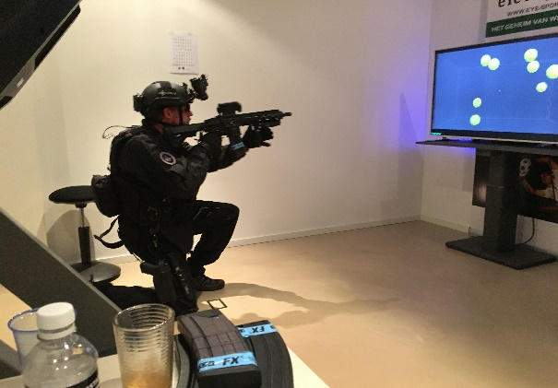
In order to train decision making under pressure we have combined tactical scene recognition followed by tactical decision and action responses while performing NeuroTracker training. NeuroTracker Tactical Awareness is a new augmented version of NeuroTracker, which integrates tactical play scenes and video sequences into the 3D environment, and can utilize forms of virtual reality, mixed reality and augmented reality to generate realistic scene recognition tasks.
Training involves tracking 4 out of 8 targets while simultaneously making tactical decisions based on a visual scene behind those targets. This method allows accurate responses to be learn with automaticity, and most importantly to do so while under high cognitive load, simulating the mental pressure that often needs be managed when performing in demanding situations or at speed.
While training and simulation programs are effective for acquiring precise skills and knowledge, generally they do not test an individual’s ability to perform when under cognitive load or stress. We must not just test the acquisition of knowledge and skills, but also test whether they can be applied under pressure, and whether this can be sustainable.
The advantage of NeuroTracker is that it automatically adapts to the users concentration threshold, ensuring any combined task can be performed under a high cognitive load. This can do safely and reliably, making it a suitable technique for assessing training efficacy.

Slide 8
Aligning the capabilities of individuals with the task responsibilities is a challenge. If a person if overloaded with demands or information, performance degrades quickly, resulting in errors and significant performance risks. Therefore assessing the realistic limits of an individuals ability to perform under pressure brings the opportunity to adapt their tasks and responsibilities so their performance can be maintained at optimal level. Training simulations combined with NeuroTracker allow specific performance thresholds to be assessed. Accordingly, the individuals number or type of tasks can be limited, or, the amount of information they should be exposed to at any given time can moderated. For example the number of feeds a radio operator should handle at any one time.
For example in flight LVC simulation environments, the pilot is constantly provided with instrumentation data. By measuring his residual cognitive capacity we can determine how well he's dealing with instrumentation data that he must deal with. In this scenario his level of instrumentation data would be reduced so as to limit information to what is essential at that very moment.
(The Iowa Rockwell Collins project)

Slide 9
Instruct and monitor training remotely. With NeuroTracker Cloud on-going training programs will provide a constant measure of cognitive capability and sustainability of the learned expertise with NeuroTracker Tactical Awareness training.
Train from the get go: email invites and NeuroTracker glasses is all that’s needed to get a whole team started on their training programs.
Full Admin control: with a simple browser login, a single person can setup users, track their progress overall and individually, view training analysis, and assign ongoing programs via an easy to use, yet powerful dashboard.
Performance transfer monitoring: using a scientifically designed sports performance Questionnaire integrated into training programs, athletes easily evaluate and record their progress on the field. Their reports are generated automatically.
Custom Dual-Task programs: coaches can quickly assign any combinations of 10 block programs of physical tasks according to the needs of each athlete. Each Dual- Task session the athlete records the difficulty level of the task he will attempt, and how well he performed it.
Scalable deployment: organizations can assign multiple adminstrators who can assign any number of users and manage them in groups, with all users monitored at any level. Large user bases can be established instantly with bulk email invites.

Slide 10
NeuroTracker Data Analytics and Reporting
Monthly Performance Reports – Using the data your team generates from hundreds of NeuroTracker sessions, we will help you identify trends that aren’t obvious to the naked
eye. We will analyze the impact of condition-specific training on your patient scores.
We also offer individual reports so that the user can track their training and be motivated on training progression programs.
Training scores can then be correlated to other individuals for a group analysis and correlation of NT scores with other performance indicators.
Biometric measures such as Heart Rate Variability are increasingly being used to assess performance levels, as they provide important insights as to how well the body systems are able to respond to various tasks. Cognitive and physiological responses are closely intertwined, for example psychological stress can trigger a range of physiological responses.
With NeuroTracker this data can be synchronized with training and being used to modify training loads during live performance. This offers another level of both measurement of performance, and optimization to each individual’s training as they change from moment to moment. By correlating cognitive to physiological and performance metrics we can determine the users optimized condition and capability for learning or for the application of expertise.

Slide 11
Richard Hoctin Boes
CEO
Eye4vision BV
+31(0180) 425639,
+31 631946320 mobile
richard@eye4vision.nl
Jean Castonguay President & CEO CogniSens Inc.
+1(855) 480-0808, ext 700 Toll free
+1(514) 212-4141mobile
jcastonguay@cognisens.com
Scott Kozak
Executive Director – Business Development CogniSens Inc.
+1(617) 412-6278
skozak@cognisens.com

